Slide 1
PepGlider: Property Regularized VAE for interpretable and controllable peptide design
Aleksandra Gwiazda
Computational Medicine Lab, University of Warsaw and AI for Health Helmholtz Munich,
Faculty of Electronics and Information Technology, Warsaw University of Technology
Warsaw, 15.10.2025

Slide 2
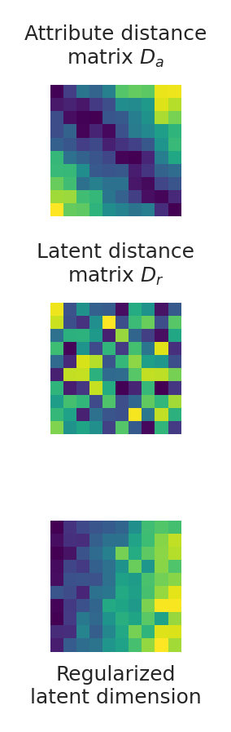

How to get property regularized VAE?
Encoder
Decoder
𝜶
disentanglement
controllable sampling / regularization
conflicting properties

Slide 3

Example: Presentation rating
poor method explanation
no jokes
good method explanation
many jokes
method explanation
number of jokes

Slide 4
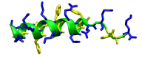
Let’s focus on antimicrobial peptides (AMP)
GVLDILKGAAKDLAGHVATKVINKI

Slide 5
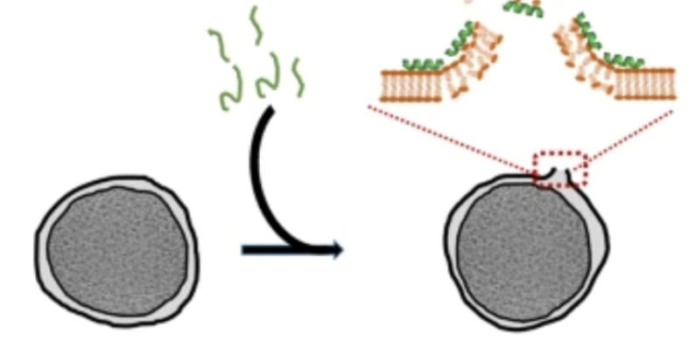
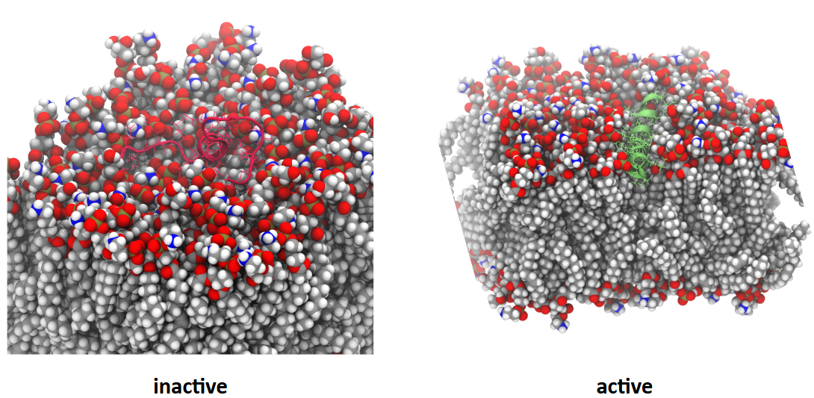
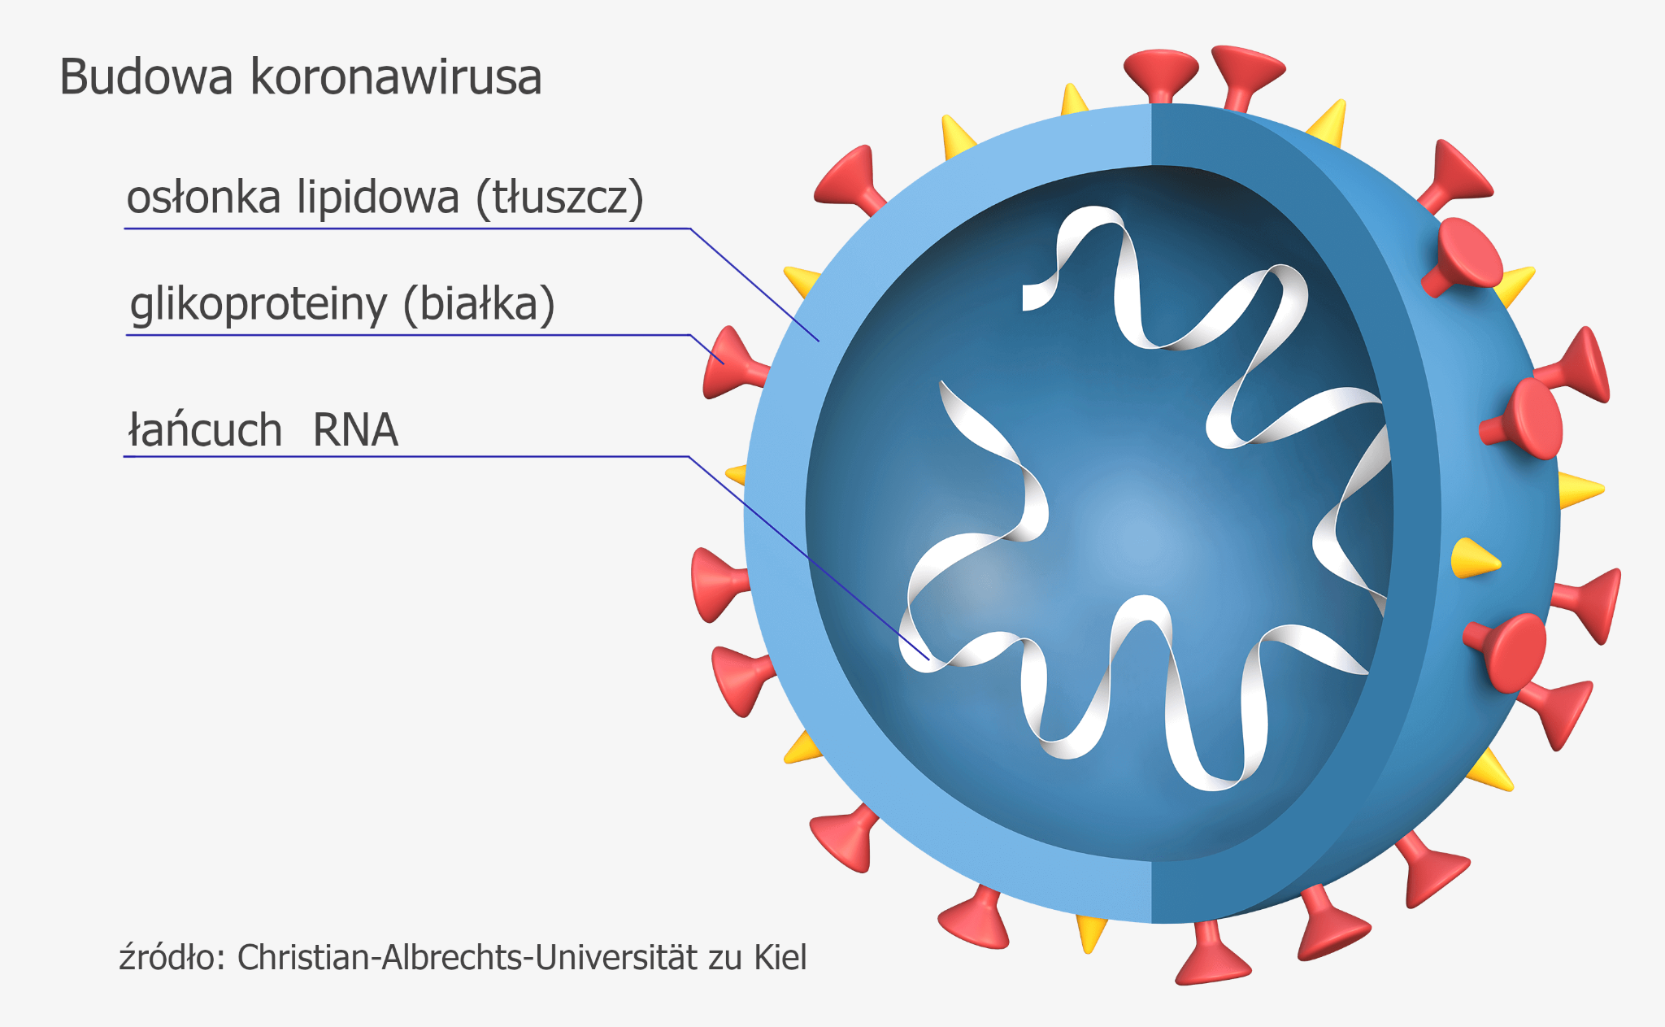
Let’s focus on antimicrobial peptides (AMP)

Slide 6
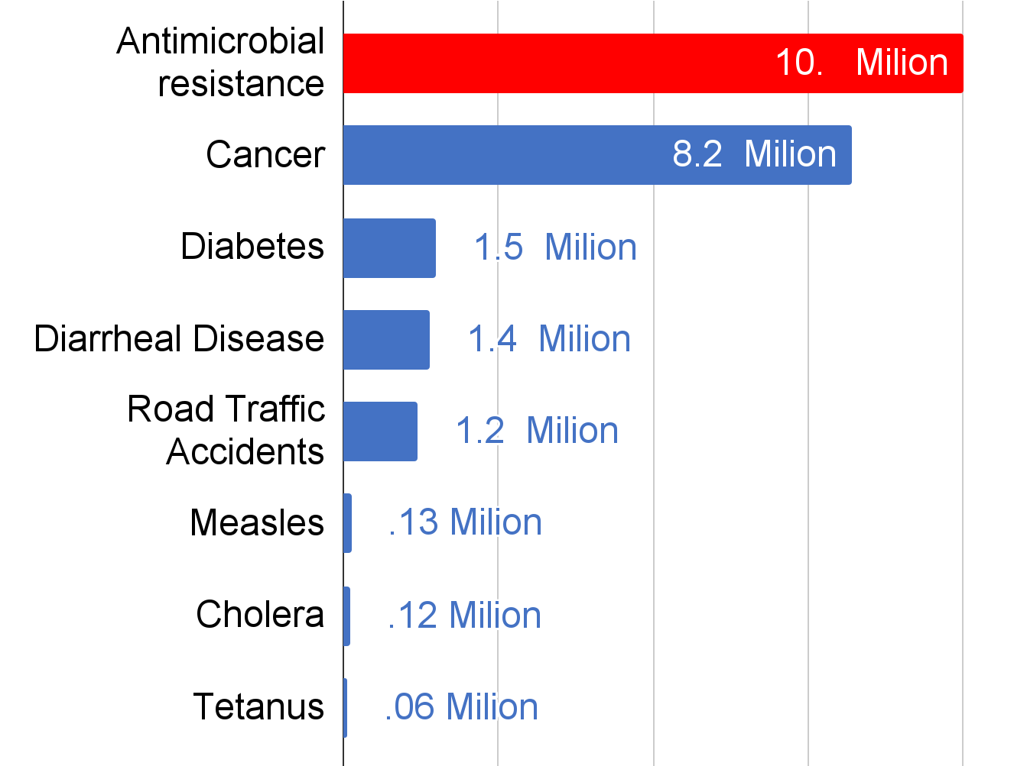
Why researching AMPs are important?
Resistance to existing antibiotics
Projected no. of deaths per 2050 (global)
Antibiotic discovery void
1990
now
O’Neil, amr-review.org, 2014
Year
Miethke et al, Nat Rev Chem, 2021
Antimicrobial Resistance Collaborators, The Lancet, 2022
https://www.who.int/campaigns/world-antimicrobial-awareness-week/2022

Slide 7
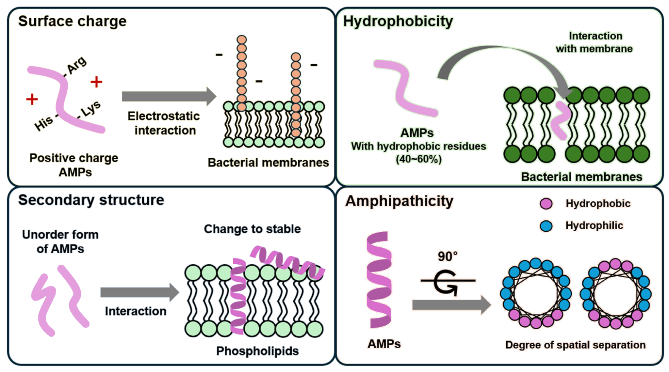
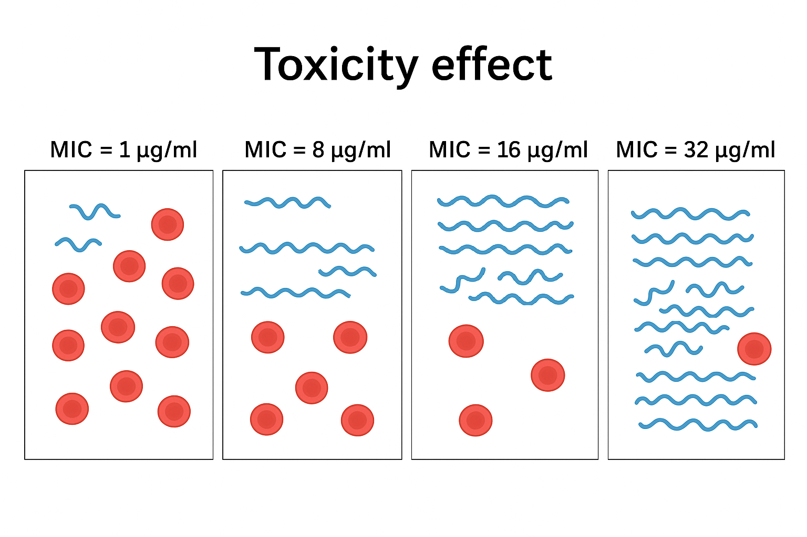
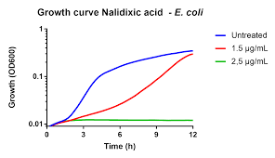
How we describe AMPs?
Minimum Inhibitory Concentration
Physicochemical
Activity
Min et al, Antibiotics, 2024

Slide 8
Why we have a problem to discover AMPs?
How to find good candidates when we have large space of possibility?
How to understand our generated peptides to synthesize them in a lab?
How to balance between conflicted attributes?

Slide 9
How can we generate AMPs?
a
Generation modes:
Unconstrained
Analog
Novel peptides
Encoder
Decoder
Prototype
peptides
Optimized analogs
GVLDILKGAAKDLAGHVATKVINKI
GVLRILKGAAKDLAGHVATKVINKI

Slide 10
How do we generate AMPs?
Architecture decisions for peptide sequence learning:
6 transformer layers - learning peptide semantic
additive, learnable positional encoding - adding important peptide information to training
4 attention heads - extract different knowledge about data in one step
Architecture decisions for providing reconstruction:
big batch size (512)
huge number of epochs (3100)
IWAE implemented (10x decoder training iteration in 1 epoch)

Slide 11
How can we generate AMPs?
a
Generation modes:
Unconstrained
Analog
Novel peptides
Encoder
Decoder
𝜶
Prototype
peptides
Optimized analogs
GVLDILKGAAKDLAGHVATKVINKI
GVLRILKGAAKDLAGHVATKVINKI

Slide 12
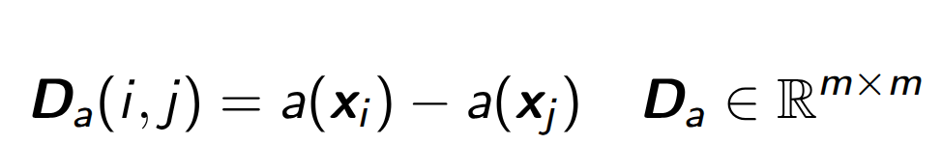
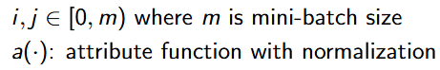
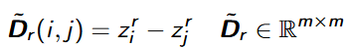
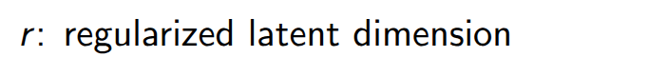
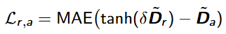
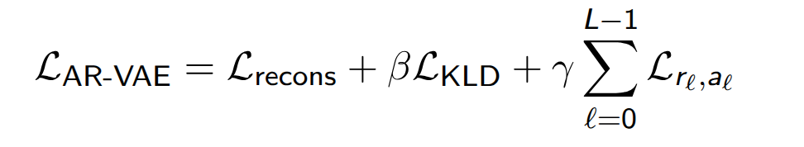
How to add AMPs properties to the training?
1. Compute attribute distance matrix D_{a}
2. Compute regularized dimension distance matrix D_{r}
3. Compute regularization loss
4. Compute total loss

Slide 13
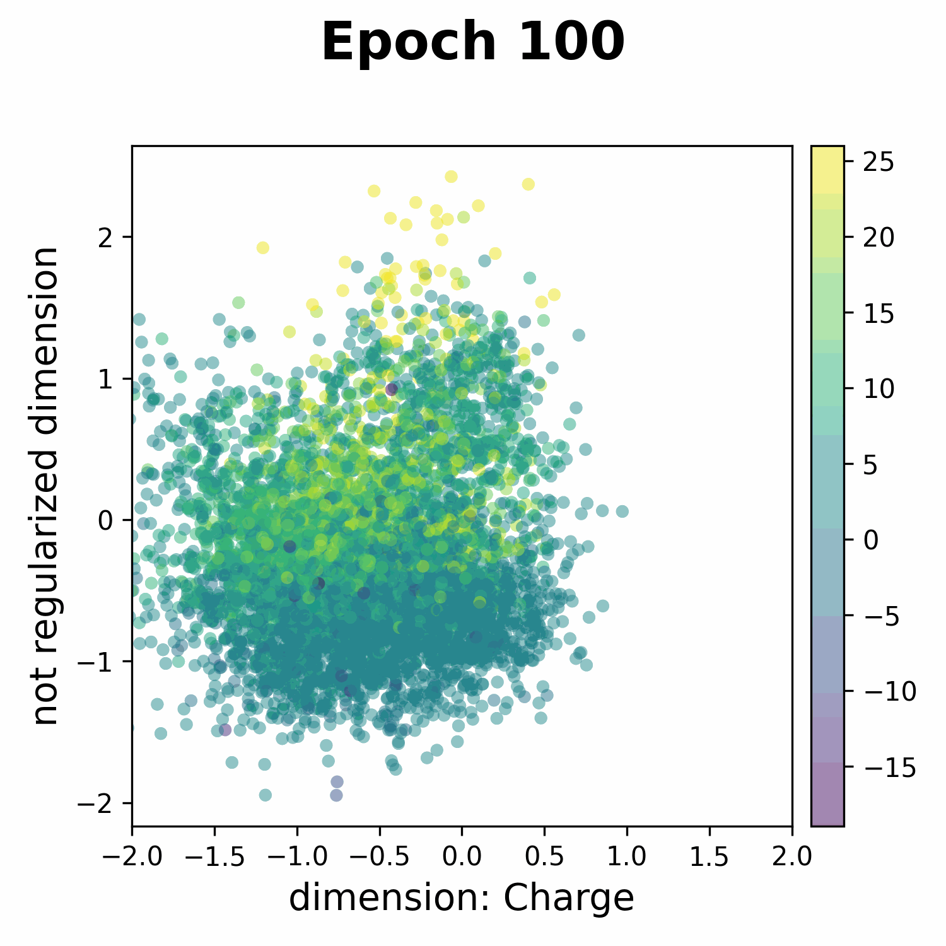
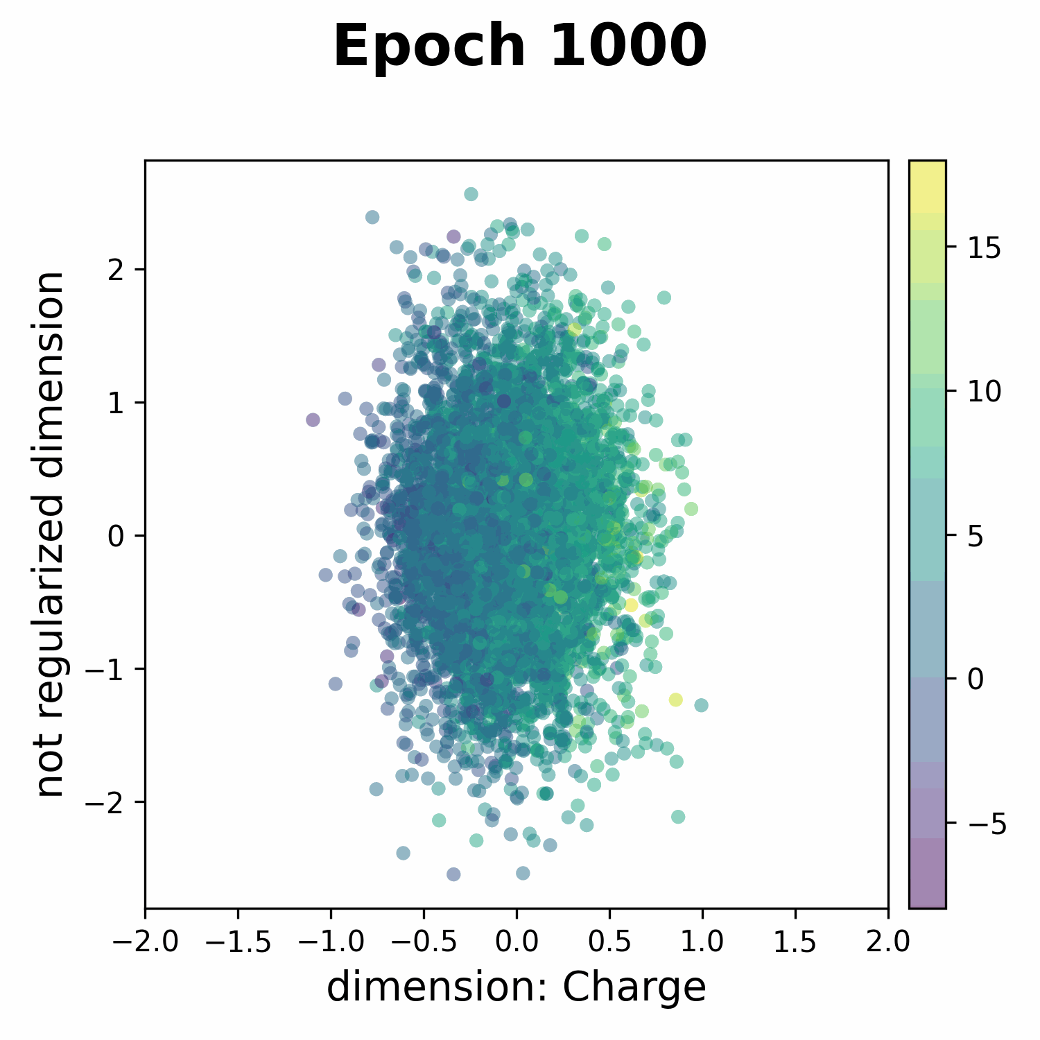
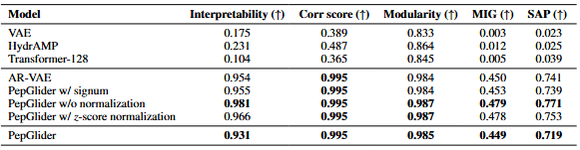
How to validate if our model goal is reached?
Notes:
Interpretability - how good it predict an attribute using only one latent space dimension
Modularity - if each dimension of the latent space depends on only one attribute
MIG - the difference of mutual information between two dimensions with which share maximum mutual information with the attribute
SAP - the difference in the prediction error of the two most predictive latent space dimensions for an attribute
Correlation score- max of Spearman’s correlation coefficient between an attribute and a dimension of the latent space

Slide 14
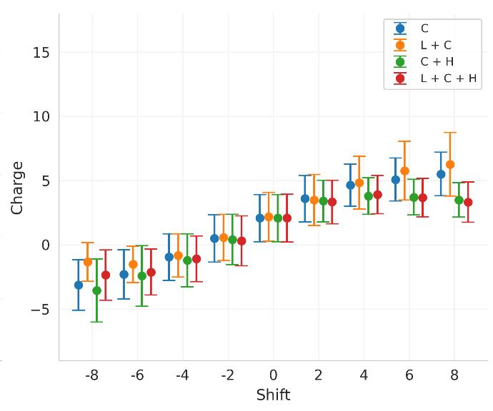
How can you use PepGlider?

Slide 15
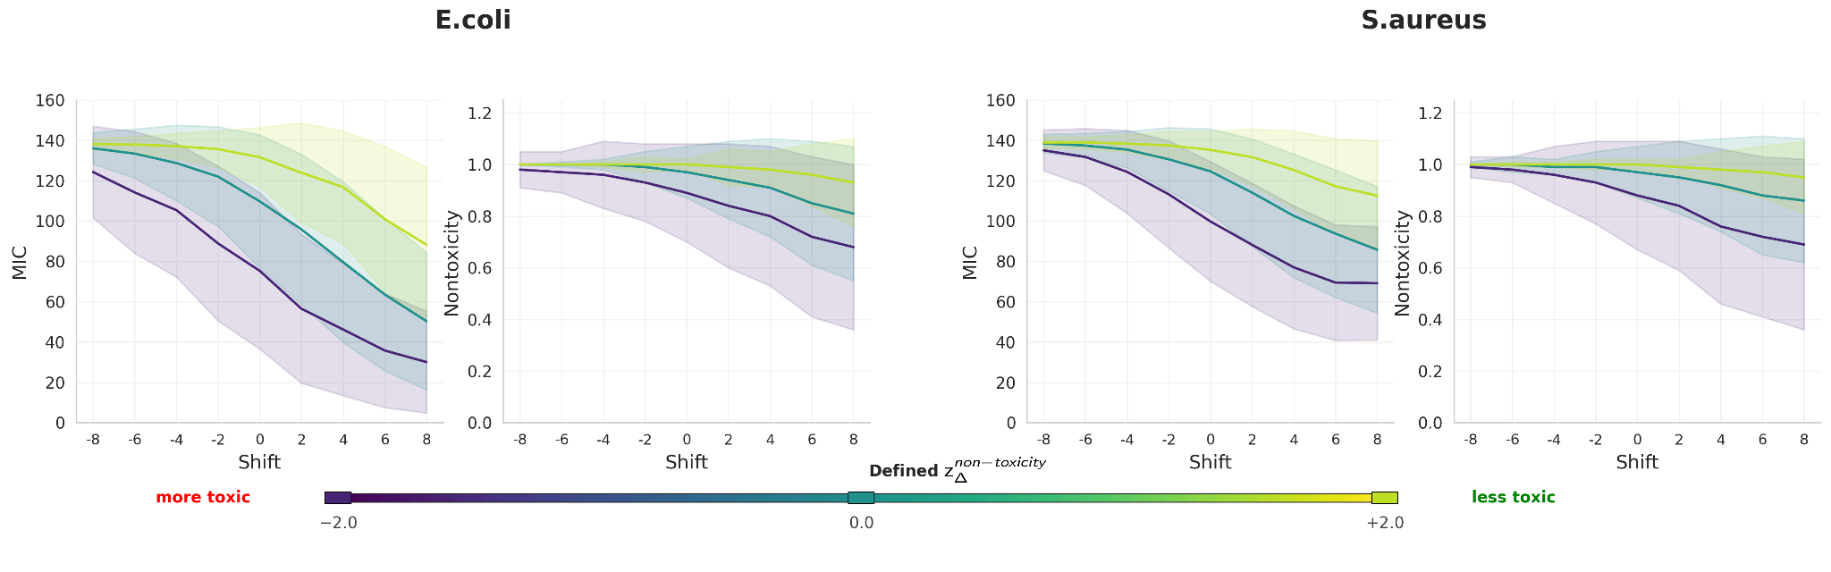
How can you use PepGlider?

Slide 16
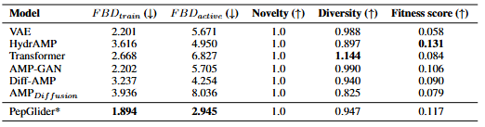
How can you use PepGlider?

Slide 17



Acknowledgments
ATHENA resources from a grant PLG/2025/018391
Preprint link
Paulina Szymczak
dr hab. Ewa Szczurek

